Slide 1
HADOOP SETUP AND PROGRAMMING
1. Hadoop Setup

Slide 2
Learning Outcomes
Upon completion of this lesson, students will be able to:
Install JAVA
Install Hadoop
Run a Hadoop program

Slide 3
OS INFO
Linux is well supported by almost all big data frameworks.
Mac (Unix-like) is similar to Linux and should be fine for most frameworks.
Windows is not well supported and may require extra effort to make it work.
Never try to run codes on Windows in this course. It is not fully compatible and hard to debug!

Slide 4
Pseudo-distributed cluster
Developing and testing your Hadoop program on your own machine before submitting to Hadoop cluster is highly recommended.
Refer to http://hadoop.apache.org/docs/current/hadoop-project-dist/hadoop-common/SingleCluster.html for installation documentation

Slide 5
Hadoop Setup for Linux

Slide 6
Java Installation
Go to http://www.oracle.com/technetwork/java/javase/downloads/index.html to download Java SE Development Kit 8u144. Remember to accept agreement and select Linux x64 jdk-8u144-linux-x64.tar.gz
Go to directory where you store the file and enter the command as shown in right figure

Slide 7
Java Installation
Rename jdk folder following commands in right figure
Install vim:
sudo apt-get install vim

Slide 8
Java Installation
Enter command:
vim ~/.profile
Enter All “export” part in the right figure at the end of this file
Press ESC, then press shift + :
Enter wq, press enter to save changes

Slide 9
Java Installation
Source this file according to command in the right figure

Slide 10
Java Installation
Verify your installation
Restart Ubuntu

Slide 11
Hadoop Setup
Install ssh and pdsh
$ sudo apt-get install ssh
$ sudo apt-get install pdsh
Download Hadoop https://archive.apache.org/dist/hadoop/common/hadoop-2.8.1/hadoop-2.8.1.tar.gz
Unzip this tar.gz file using command on right figure
Go to installation directory and rename the folder to hadoop
mv ~/Documents/hadoop-2.8.1/ ~/Documents/hadoop

Slide 12
Hadoop Setup
Enter following command in terminal:
vim ~/.profile
Add content marked by red line at end of file
Save and exit
source ~/.profile

Slide 13
Check Setup

Slide 14
Change JAVA_HOME In HADOOP-ENV.SH

Slide 15
Pseudo-distributed mode
Go to Hadoop folder, open core-site.xml
Enter content in the right image
Save and exit

Slide 16
Pseudo-distributed mode
Go to Hadoop folder, open hdfs-site.xml
Enter content in the right image
Save and exit

Slide 17
Pseudo-distributed mode
Ssh to local host
Format namenode
start-dfs.sh

Slide 18
Verification
Browse the web interface for the NameNode; by default it is available at:
NameNode - http://localhost:9870/
Create your own directory

Slide 19
Verification
Use following command to upload data:
Hdfs dfs –put ~/Documents/hadoop/etc/hadoop/*.xml/user/alan/input

Slide 20
Start Hadoop Task
Execute following command to start a hadoop task

Slide 21
Check Output

Slide 22
You are done!
You should execute start-dfs.sh every time you want to start Hadoop

Slide 23
Hadoop Setup for Mac

Slide 24
Hadoop Setup for Mac
Install Java
Install Homebrew (find more info on https://brew.sh/)
ruby -e "$(curl -fsSL https://raw.githubusercontent.com/Homebrew/install/master/install)”
brew update
Install Hadoop
brew install Hadoop
Hadoop will be installed at path /usr/local/Cellar/Hadoop
Suppose installed Hadoop version is 2.7.3

Slide 25
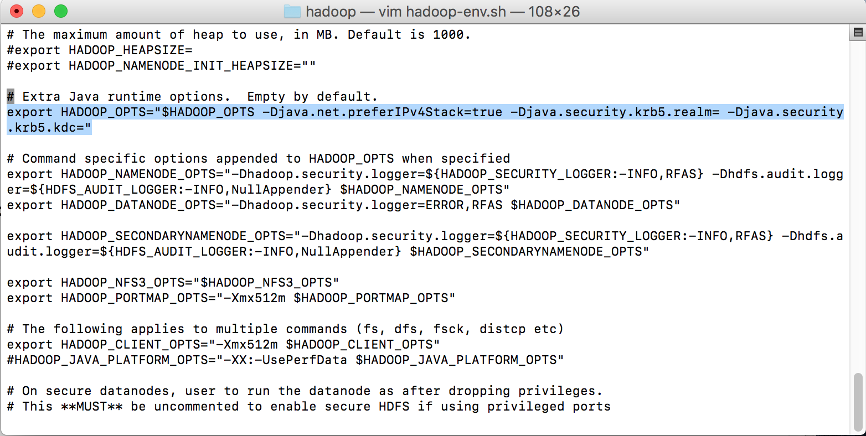
Modify Configuration Files
Go to /usr/local/Cellar/hadoop/2.7.3/libexec/etc/hadoop/
Open hadoop-env.sh
Change following line with the line in the image
export HADOOP_OPTS="$HADOOP_OPTS -Djava.net.preferIPv4Stack=true"

Slide 26
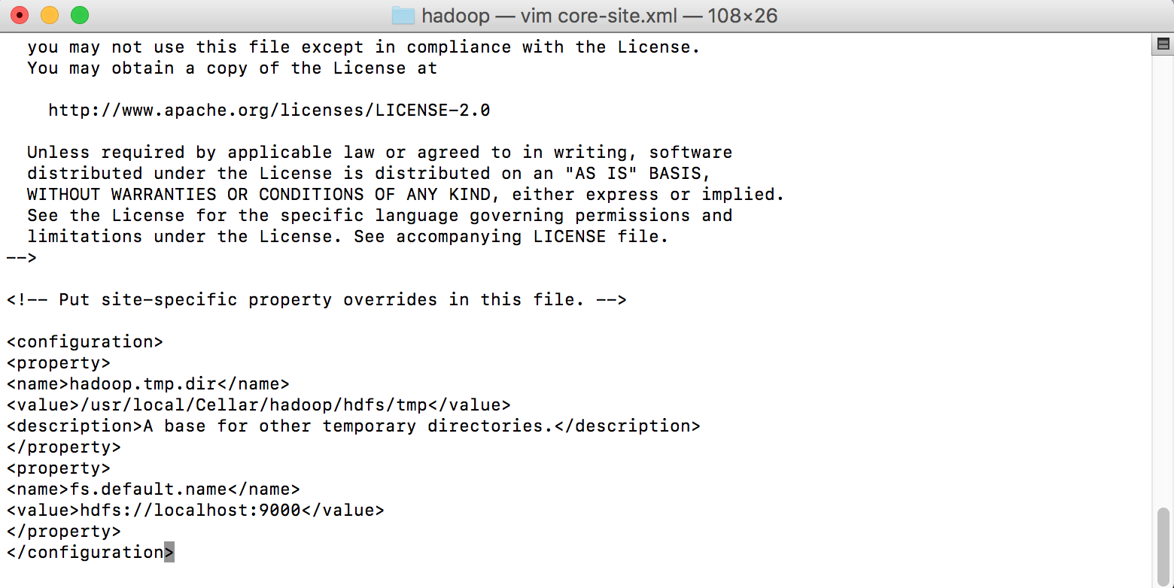
Modify Configuration Files
Go to /usr/local/Cellar/hadoop/2.7.3/libexec/etc/hadoop/
Open core-site.xml
Add the property inside the <configuration> tag, just like the image
<property>
<name>hadoop.tmp.dir</name> <value>/usr/local/Cellar/hadoop/hdfs/tmp</value>
<description>A base for other temporary directories.</description>
</property>
<property>
<name>fs.default.name</name> <value>hdfs://localhost:9000</value> </property>

Slide 27
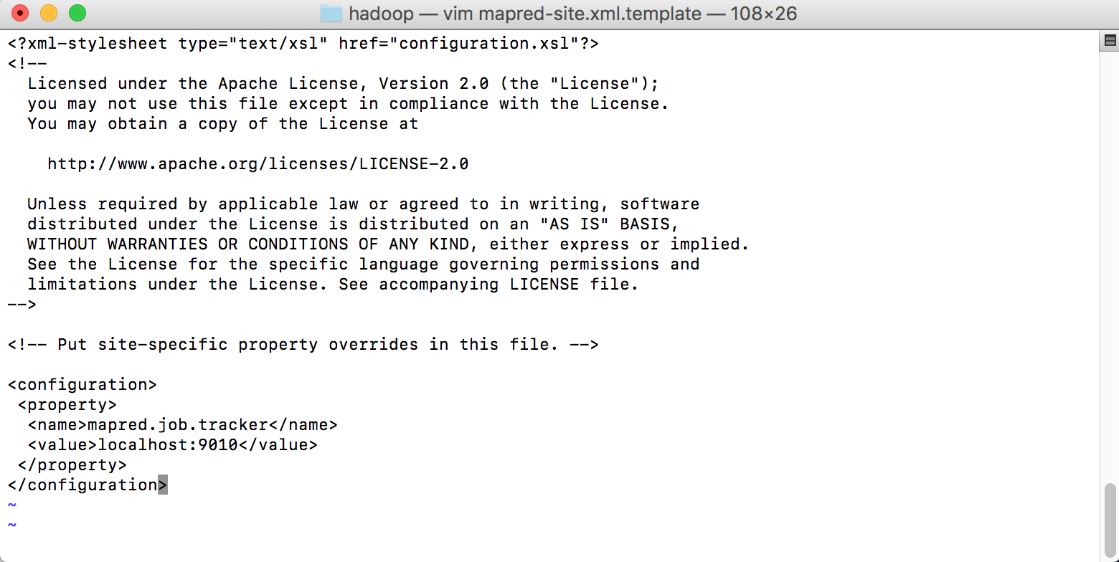
Modify Configuration Files
Go to /usr/local/Cellar/hadoop/2.7.3/libexec/etc/hadoop/
Open mapred-site.xml
Add the property inside the <configuration> tag, just like the image
<property> <name>mapred.job.tracker</name> <value>localhost:9010</value> </property>

Slide 28
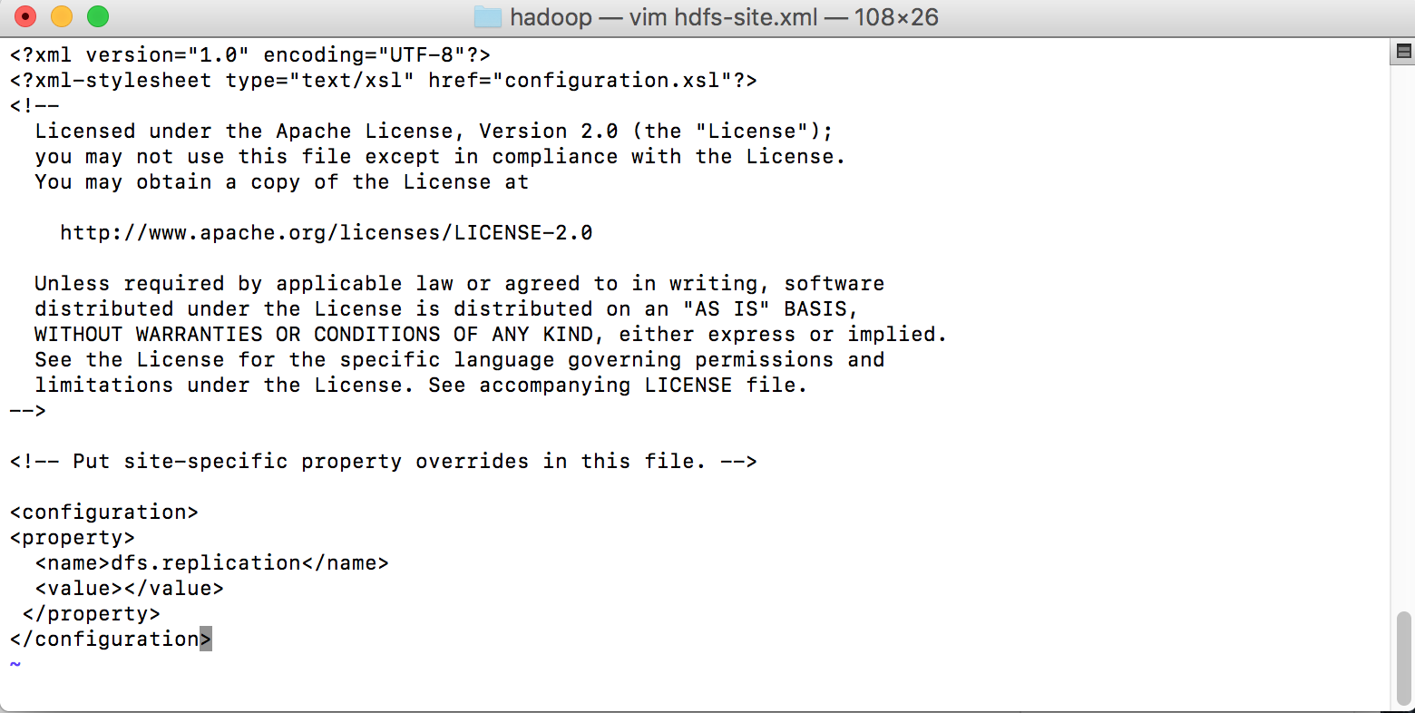
Modify Configuration Files
Go to /usr/local/Cellar/hadoop/2.7.3/libexec/etc/hadoop/
Open hdfs-site.xml
Add the property inside the <configuration> tag, just like the image
<property>
<name>dfs.replication</name> <value></value>
</property>

Slide 29
Modify Configuration Files
ssh to localhost
If ssh to localhost failed, then try:
sudo systemsetup -setremotelogin on
ssh localhost
Before running Hadoop, format HDFS namenode
hdfs namenode -format

Slide 30
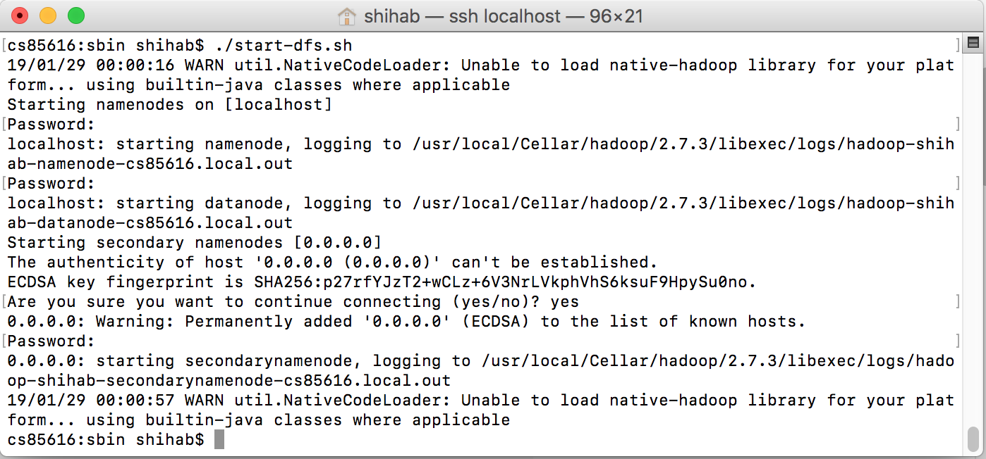
Launch Hadoop
Go to /usr/local/Cellar/hadoop/2.7.3/sbin
To start HDFS service:
./start-dfs.sh
To stop HDFS service
./stop-dfs.sh

Slide 31
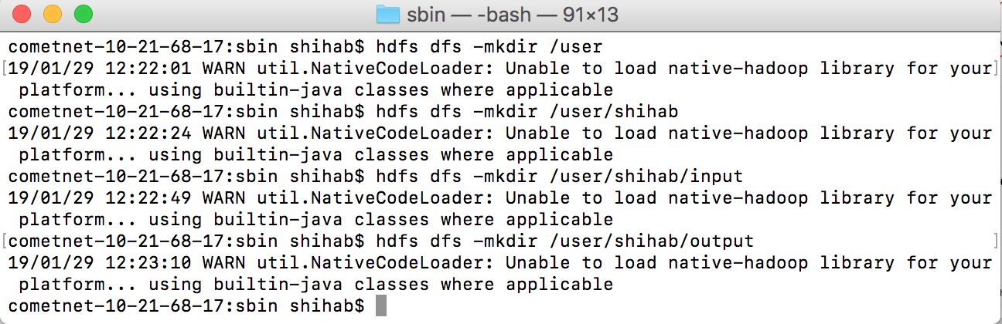
Verification
Browse the web interface for the NameNode; by default it is available at:
http://localhost:50070
Create your own directory in hdfs

Slide 32
You are done!
You should execute start-dfs.sh every time you want to start Hadoop

